Slide 1
Path-Reporting Distance Oracles with Logarithmic Stretch and Linear Size
Shiri Chechik Tianyi Zhang
Tel Aviv University

Slide 2
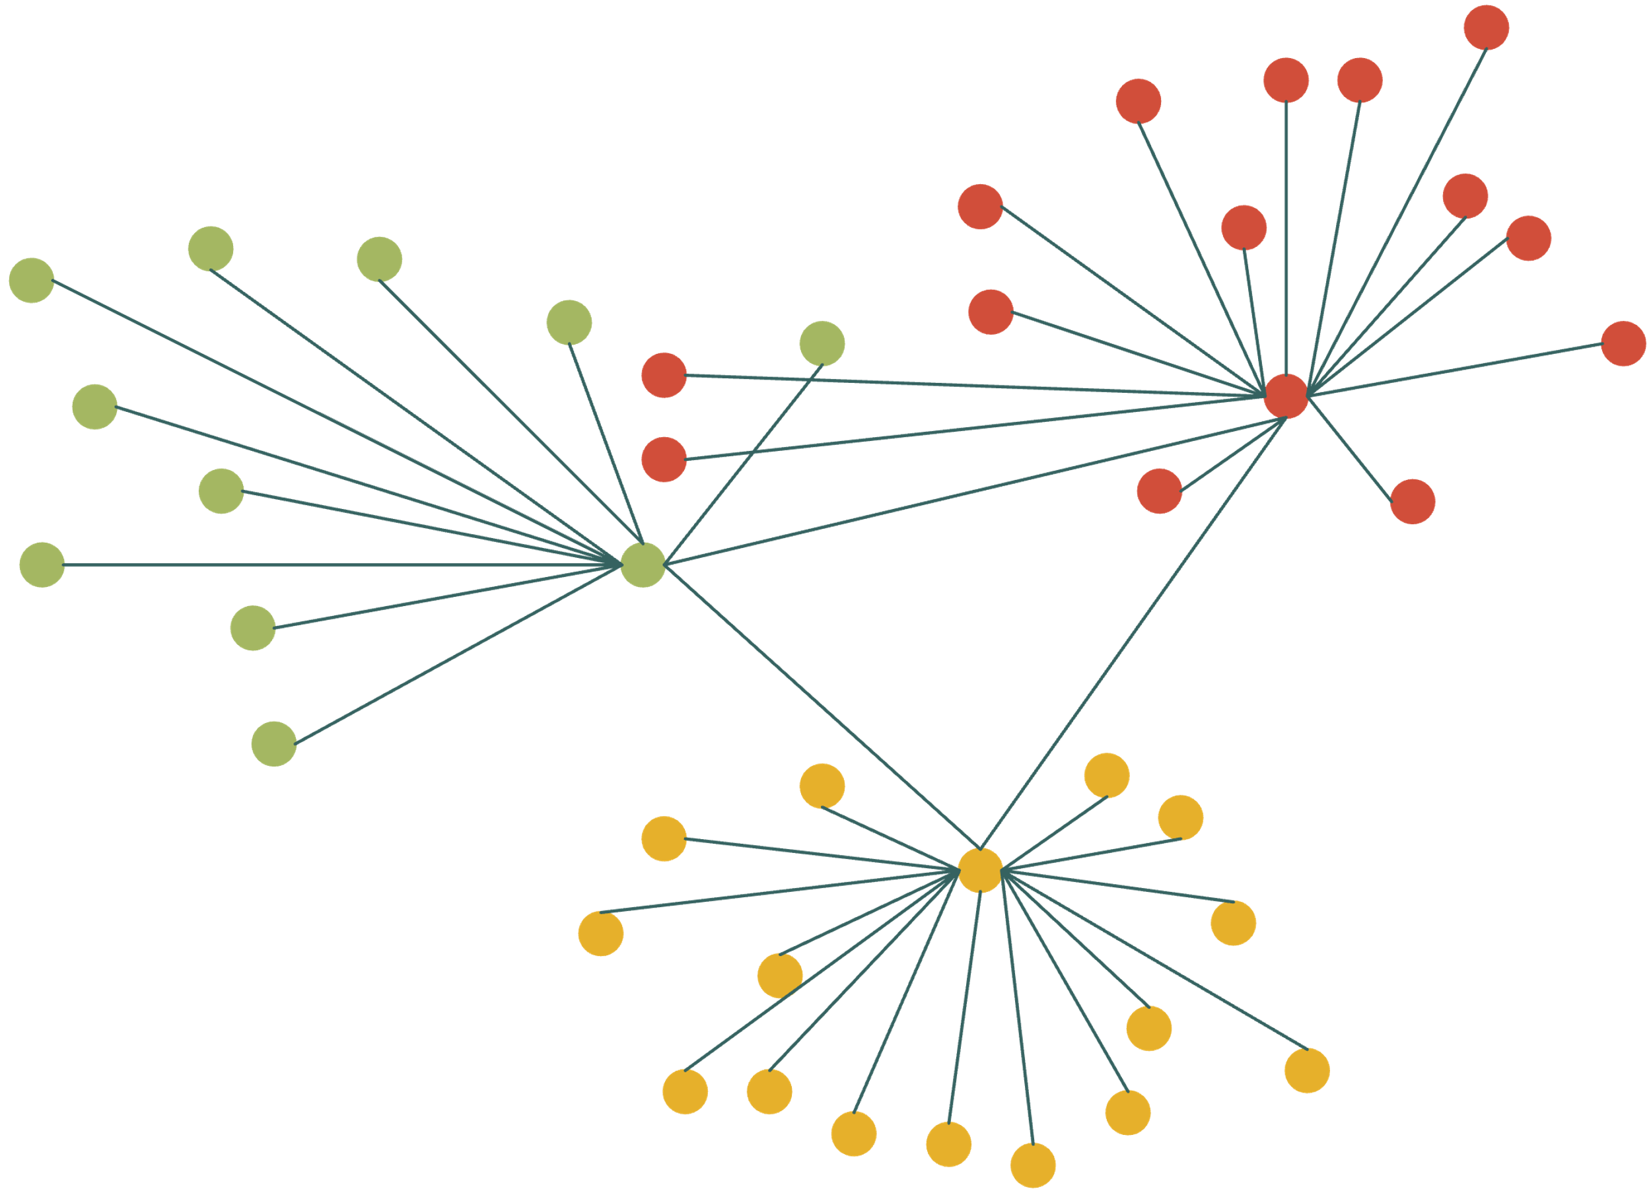
Graph Metric Compression
Compress a large graph into a small representation
large graph
small representation
compress
preserve
distances
Examples: trees, spanners, distance oracles

Slide 3
Distance Oracles
Compact data structure that quickly estimates distances in graphs
Goal: small space, small stretch error, fast query time
input graph
distance oracle
preprocess
queries
distance
estimates

Slide 4
Distance Oracles
Given an undirected weighted graph G = (V, E, w)
Goal: design a space-efficient data structure
For any $s, t∈V$, efficiently compute $α$-approximate distance $dist\left(s, t, G\right)≤est\left(s, t, G\right)≤α⋅dist(s, t, G)$
Trade-off between space and stretch bound $α$

Slide 5
Typical Examples
Cost metrics: space, stretch, and query time
Distance matrix:
Space: $n^{2}$
Stretch: $1$
Query time: $O(1)$
Thorup-Zwick:
Space: $O\left(kn^{1+1/k}\right)$
Stretch: $2k−1$
Query time: $O(k)$
The girth conjecture:
Space: $Ω(n^{1+1/k})$
Stretch: $2k−1$
Query time: -

Slide 6
History of Distance Oracles
 | stretch | space | query time
Lower bound based on the girth conjecture | $$2k−1$$ | $$Ω(n^{1+1/k})$$ | -
Awerbuch, Berger, Cowen and Peleg, 1993 | $$64k$$ | $$O(kn^{1+1/k})$$ | $$O(kn^{1/k})$$
Cohen, 1993 | $$(2+ϵ)k$$ | $$O(kn^{1+1/k})$$ | $$O(kn^{1/k})$$
Thorup-Zwick, 2001 | $$2k−1$$ | $$O(kn^{1+1/k})$$ | $$O(k)$$
Mendel-Naor, 2006 | $$128k$$ | $$O(n^{1+1/k})$$ | $$O(1)$$
Wulff-Nilsen, 2012 | $$2k−1$$ | $$O(kn^{1+1/k})$$ | $$O(\log{k})$$
Chechik, 2014 & 2015 | $$2k−1$$ | $$O(n^{1+1/k})$$ | $$O(1)$$

Slide 7
Path-Reporting Distance Oracles
Want an actual path rather than a distance value
Path-reporting vs. non-path-reporting
s
t
s
t
actual path
$$est(s, t, G)$$
Standard requirement:
Print a path $ρ$ of length $est(s, t, G)$ in time $O(|ρ|)$

Slide 8
Discussion
Other forms of path vs. shortcut in graph metric compression
Paths are not known to be harder than shortcuts
Trees: low-stretch spanning tree (spanning tree) vs. probabilistic tree embedding (new shortcuts/vertices)
Sparsifiers: spanner (subgraphs) vs. emulator (new shortcuts)

Slide 9
History of Path-Reporting Distance Oracles
 | stretch | space | query time | path-report?
Thorup-Zwick, 2001 | $$2k−1$$ | $$O(kn^{1+1/k})$$ | $$O(k)$$ | yes
Mendel-Naor, 2006 | $$128k$$ | $$O(n^{1+1/k})$$ | $$O(1)$$ | no
Wulff-Nilsen, 2012 | $$2k−1$$ | $$O(kn^{1+1/k})$$ | $$O(\log{k})$$ | yes
Chechik, 2014 & 2015 | $$2k−1$$ | $$O(n^{1+1/k})$$ | $$O(1)$$ | no
Elkin-Pettie, 2015 | $${\left(1/ε\right)}^{O(1)}⋅k=O(k)$$ | $$O(n^{1+1/k})$$ | $$O(n^{ε})$$ | yes
Elkin-Shabat, 2023 | $$\left(4+ε\right)⋅k=O(k)$$ | $$O(n^{1+\frac{1}{k}}⋅log k)$$ | $$O(log k)$$ | yes
Elkin-Shabat, 2023 | $$\left(24+ε\right)⋅k=O(k)$$ | $$O(n^{1+\frac{1}{k}}⋅log k)$$ | $$O(log log k)$$ | yes
Elkin-Shabat, 2023 | $$O(k\log{k})$$ | $$O(n^{1+\frac{1}{k}})$$ | $$O(log log k)$$ | yes
Question: Can we achieve $O(k)$ stretch optimal space $O(n^{1+1/k})$ simultaneously (in log query time)?

Slide 10
History of Path-Reporting Distance Oracles
 | stretch | space | query time | path-report?
Thorup-Zwick, 2001 | $$2k−1$$ | $$O(kn^{1+1/k})$$ | $$O(k)$$ | yes
Mendel-Naor, 2006 | $$128k$$ | $$O(n^{1+1/k})$$ | $$O(1)$$ | no
Wulff-Nilsen, 2012 | $$2k−1$$ | $$O(kn^{1+1/k})$$ | $$O(\log{k})$$ | yes
Chechik, 2014 & 2015 | $$2k−1$$ | $$O(n^{1+1/k})$$ | $$O(1)$$ | no
Elkin-Pettie, 2015 | $${\left(1/ε\right)}^{O(1)}⋅k=O(k)$$ | $$O(n^{1+1/k})$$ | $$O(n^{ε})$$ | yes
Elkin-Shabat, 2023 | $$\left(4+ε\right)⋅k=O(k)$$ | $$O(n^{1+\frac{1}{k}}⋅log k)$$ | $$O(log k)$$ | yes
Elkin-Shabat, 2023 | $$\left(24+ε\right)⋅k=O(k)$$ | $$O(n^{1+\frac{1}{k}}⋅log k)$$ | $$O(log log k)$$ | yes
Elkin-Shabat, 2023 | $$O(k\log{k})$$ | $$O(n^{1+\frac{1}{k}})$$ | $$O(log log k)$$ | yes
New | $$12k=O(k)$$ | $$O(n^{1+\frac{1}{k}})$$ | $$O(log log k)$$ | yes
Question: Can we achieve $O(k)$ stretch optimal space $O(n^{1+1/k})$ simultaneously (in log query time)?

Slide 11
Our techniques
PRDOs using exact distance preservers [Pettie-Elkin, 2015]
PRDOs using hop-sets [Elkin-Shabat, 2023] and stretch-friendly partitions [Bezdrighin et al, 2022]
Our PRDOs using cluster covers [Chechik, 2015] and stretch-friendly partitions [Bezdrighin et al, 2022] differently

Slide 12
DOs using Cluster Covers [Chechik, 2015]
Hierachy of pivots [TZ, 2001] $$V=A_{0}⊆A_{1}⊆⋯⊆A_{k−1}⊆A_{k}$$
Level$i+1$
Subsample
prob = $n^{−1/k}$
Level$i$
……
……
Level $0$

Slide 13
DOs using Cluster Covers [Chechik, 2015]
Hierachy of pivots [TZ, 2001] $$V=A_{0}⊆A_{1}⊆⋯⊆A_{k−1}⊆A_{k}$$
Query distance between $s,t∈V$
Level$k/2$
s
t

Slide 14
DOs using Cluster Covers [Chechik, 2015]
Hierachy of pivots [TZ, 2001] $$V=A_{0}⊆A_{1}⊆⋯⊆A_{k−1}⊆A_{k}$$
Query distance between $s,t∈V$
Find the closest pivots $u,v∈A_{\frac{k−1}{2}}$
$$u∈A_{\frac{k−1}{2}}$$
$$v∈A_{\frac{k−1}{2}}$$
closest
pivot
closest
pivot
s
t

Slide 15
DOs using Cluster Covers [Chechik, 2015]
Hierachy of pivots [TZ, 2001] $$V=A_{0}⊆A_{1}⊆⋯⊆A_{k−1}⊆A_{k}$$
Query distance between $s,t∈V$
Find the closest pivots $u,v∈A_{\frac{k−1}{2}}$
If $dist\left(s, u\right),dist\left(t,v\right)≤\frac{k−1}{2}⋅dist\left(s,t\right)$ then return the distance estimate: $dist\left(s, u\right)+dist\left(u,v\right)+dist(v,t)$
$$u∈A_{\frac{k−1}{2}}$$
$$v∈A_{\frac{k−1}{2}}$$
Store the
distance value
Can store the
shortest path
Can store the
shortest path
s
t

Slide 16
DOs using Cluster Covers [Chechik, 2015]
Hierachy of pivots [TZ, 2001] $$V=A_{0}⊆A_{1}⊆⋯⊆A_{k−1}⊆A_{k}$$
Query distance between $s,t∈V$
Find the closest pivots $u,v∈A_{\frac{k−1}{2}}$
If $dist\left(s, u\right),dist\left(t,v\right)≤\frac{k−1}{2}⋅dist\left(s,t\right)$ then return the distance estimate: $dist\left(s, u\right)+dist\left(u,v\right)+dist(v,t)$
$$u∈A_{\frac{k−1}{2}}$$
$$v∈A_{\frac{k−1}{2}}$$
Can store the path
with some error
Can store the
shortest path
Can store the
shortest path
s
t

Slide 17
DOs using Cluster Covers [Chechik, 2015]
Hierachy of pivots [TZ, 2001] $$V=A_{0}⊆A_{1}⊆⋯⊆A_{k−1}⊆A_{k}$$
Query distance between $s,t∈V$
Find the closest pivots $u,v∈A_{\frac{k−1}{2}}$
Main case: $dist\left(s, u\right),dist\left(t,v\right)>\frac{k−1}{2}⋅dist\left(s,t\right)$ Use cluster covers
$$u∈A_{\frac{k−1}{2}}$$
$$v∈A_{\frac{k−1}{2}}$$
s
t
dist(s, u) is much longer than dist(s, t)

Slide 18
DOs using Cluster Covers [Chechik, 2015]
Main case: $$dist\left(s, u\right),dist\left(t,v\right)>\frac{k−1}{2}⋅dist\left(s,t\right)$$
Cluster covers
$V=C_{1}∪C_{2}∪⋯∪C_{l}$
$$u∈A_{\frac{k−1}{2}}$$
$$v∈A_{\frac{k−1}{2}}$$
s
t

Slide 19
DOs using Cluster Covers [Chechik, 2015]
Main case: $$dist\left(s, u\right),dist\left(t,v\right)>\frac{k−1}{2}⋅dist\left(s,t\right)$$
Cluster covers
$V=C_{1}∪C_{2}∪⋯∪C_{l}$
Pick one $C_{i}$ containing both s,t, $rad(C_{i})≤dist\left(s, u\right),dist\left(t,v\right)$
$$u∈A_{\frac{k−1}{2}}$$
$$v∈A_{\frac{k−1}{2}}$$
s
t

Slide 20
DOs using Cluster Covers [Chechik, 2015]
Main case: $$dist\left(s, u\right),dist\left(t,v\right)>\frac{k−1}{2}⋅dist\left(s,t\right)$$
Cluster covers
$V=C_{1}∪C_{2}∪⋯∪C_{l}$
Pick one $C_{i}$ containing both s,t, $rad(C_{i})≤dist\left(s, u\right),dist\left(t,v\right)$
$C_{i}$ has a center c which stores $dist(c, z)$ for all $z∈C_{i}$, and return $est\left(s, t\right)=dist\left(s, c\right)+dist(c,t)$
$$u∈A_{\frac{k−1}{2}}$$
$$v∈A_{\frac{k−1}{2}}$$
c
s
t

Slide 21
DOs using Cluster Covers [Chechik, 2015]
Cluster covers:
$$A_{\frac{k−1}{2}}$$

Slide 22
DOs using Cluster Covers [Chechik, 2015]
Cluster covers:
Pick an arbitrary vertex $v∉A_{\frac{k−1}{2}}$ Define $d=\frac{2}{k−1} dist(v,A_{\frac{k−1}{2}})$
$$A_{\frac{k−1}{2}}$$
$$dist(v,A_{\frac{k−1}{2}})$$
v

Slide 23
DOs using Cluster Covers [Chechik, 2015]
Cluster covers:
Pick an arbitrary vertex $v∉A_{\frac{k−1}{2}}$ Define $d=\frac{2}{k−1} dist(v,A_{\frac{k−1}{2}})$
Find an integer $1≤r≤\frac{k−1}{2}$ s.t. $\left|B\left(v, rd\right)\right|≤n^{\frac{1}{k}}⋅|B(v,\left(r−1\right)d)|$
$$A_{\frac{k−1}{2}}$$
(r-1)d
rd
v

Slide 24
DOs using Cluster Covers [Chechik, 2015]
Cluster covers:
Pick an arbitrary vertex $v∉A_{\frac{k−1}{2}}$ Define $d=\frac{2}{k−1} dist(v,A_{\frac{k−1}{2}})$
Find an integer $1≤r≤\frac{k−1}{2}$ s.t. $\left|B\left(v, rd\right)\right|≤n^{\frac{1}{k}}⋅|B(v,\left(r−1\right)d)|$
Store distances values $dist(v,z)$, for all $z∈B\left(v, rd\right)$
$$A_{\frac{k−1}{2}}$$
rd
v
$$dist(v,z)$$
z

Slide 25
DOs using Cluster Covers [Chechik, 2015]
Cluster covers:
Pick an arbitrary vertex $v∉A_{\frac{k−1}{2}}$ Define $d=\frac{2}{k−1} dist(v,A_{\frac{k−1}{2}})$
Find an integer $1≤r≤\frac{k−1}{2}$ s.t. $\left|B\left(v, rd\right)\right|≤n^{\frac{1}{k}}⋅|B(v,\left(r−1\right)d)|$
Store distances values $dist(v,z)$, for all $z∈B\left(v, rd\right)$
Remove $B(v,\left(r−1\right)d)$ and repeat
$$A_{\frac{k−1}{2}}$$
(r-1)d
rd
v

Slide 26
Non-Path-ness of Cluster Covers
Non-path issue:
Remove $B(v,\left(r−1\right)d)$ after storing distances
rd
v
$$dist(v,z)$$
z

Slide 27
Non-Path-ness of Cluster Covers
Non-path issue:
Remove $B(v,\left(r−1\right)d)$ after storing distances
v

Slide 28
Non-Path-ness of Cluster Covers
Non-path issue:
Remove $B(v,\left(r−1\right)d)$ after storing distances
$B(v,\left(r−1\right)d)$ might intersect with the next ball $B(v′, r′d′)$
(r’-1)d’
v
v’
r’d’

Slide 29
Non-Path-ness of Cluster Covers
Non-path issue:
Remove $B(v,\left(r−1\right)d)$ after storing distances
$B(v,\left(r−1\right)d)$ might intersect with the next ball $B(v′, r′d′)$
Storing shortest paths could be expensive that cross removed regions
v
v’

Slide 30
Idea: Use Tree Covers
Fixing non-path issue:
Grow new balls $B(v′, r′d′)$ in the induced subgraph
(r’-1)d’
v
v’
r’d’

Slide 31
Idea: Use Tree Covers
Fixing non-path issue:
Grow new balls $B(v′, r′d′)$ in the induced subgraph
Store shortest paths tree
O(1)-blowup of distance stretch when plugged in the DO construction
v
v’

Slide 32
Tree Covers for the Hierarchy
Main case: $$dist\left(s, u\right),dist\left(t,v\right)>\frac{k−1}{2}⋅dist\left(s,t\right)$$
Tree covers
$V=C_{1}∪C_{2}∪⋯∪C_{l}$
Pick one $C_{i}$ containing both s,t, $rad(C_{i})≤dist\left(s, u\right),dist\left(t,v\right)$
Return the path $sc∘ct$
w$\left(sc∘ct\right)≤dist\left(s, u\right)+dist\left(t,v\right)$
u
v
$$A_{(k−1)/2}$$
c
s
t

Slide 33
Tree Covers for the Hierarchy
Main case: $$dist\left(s, u\right),dist\left(t,v\right)>\frac{k−1}{2}⋅dist\left(s,t\right)$$
Tree covers
$V=C_{1}∪C_{2}∪⋯∪C_{l}$
Pick one $C_{i}$ containing both s,t, $rad(C_{i})≤dist\left(s, u\right),dist\left(t,v\right)$
Return the path $sc∘ct$
w$\left(sc∘ct\right)≤dist\left(s, u\right)+dist\left(t,v\right)$
u
v
$$A_{(k−1)/2}$$
c
Too
close!
s
t
What if $dist\left(s,t\right)≪\frac{1}{k}dist\left(s,u\right)?$

Slide 34
Tree Covers for the Hierarchy
Main case: $$dist\left(s, u\right),dist\left(t,v\right)>\frac{k−1}{2}⋅dist\left(s,t\right)$$
Tree covers
$V=C_{1}∪C_{2}∪⋯∪C_{l}$
Pick one $C_{i}$ containing both s,t, $rad(C_{i})≤dist\left(s, u\right),dist\left(t,v\right)$
Return the path $sc∘ct$
w$\left(sc∘ct\right)≤dist\left(s, u\right)+dist\left(t,v\right)$
$$A_{(k−1)/2}$$
…
u
v
$$A_{(k−1)/2^{j}}$$
c
Build tree covers on
multiple levels
s
t
Issue: total space = $O(n^{1+\frac{1}{k}}\log{k})$

Slide 35
Tree Covers for the Hierarchy
Tree covers on multi-level:
Stretch/error on level $(k−1)/2^{j}$ is roughly $O(k/2^{j})$, better than $O(k)$
Idea: use less than $O(n^{1+1/k})$ space for lower levels
Stretch-friendly partitions [Bezdrighin et al, 2022]
$$A_{(k−1)/2}$$
…
u
v
$$A_{(k−1)/2^{j}}$$
c
Build tree covers on
multiple levels
s
t
Issue: total space = $O(n^{1+\frac{1}{k}}\log{k})$

Slide 36
Tree Covers + Stretch-Friendly Partitions
Stretch-friendly partitions
[Bezdrighin et al, 2022]
Given any param $2^{j}$
Partition graph into $O(n/2^{j})$ groups
Distance distortion by ${≤O(2}^{j})$ in the contracted graph
Tree cover for level $2^{j}$:
Space = $O\left.\left({\left(n/2^{j}\right)}^{1+1/k}\right.\right)$
Stretch = $O\left.\left(\frac{k}{2^{j}}⋅2^{j}\right.\right)=O(k)$

Slide 37
Conclusion
PR-DOs in $O\left(n^{1+\frac{1}{k}}\right)$ space, $O(k)$ stretch, $O(\log{\log{k}})$ query time
Main question: Improve to $2k−1$ stretch and $O\left(1\right)$ query time?

